Slide 1
Plan
An Introduction To The Problem
Vanilla GAN
Wasserstein GAN
Discrete Wasserstein GAN
Experiments With Movielens-1M Sparse Data And Theoretical Analysis Of The results

Slide 2
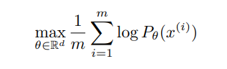
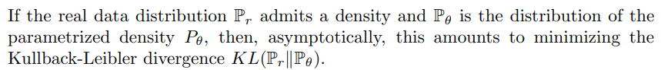
Formulation Of The Problem
Part 0 - An Introduction To The Problem

Slide 3
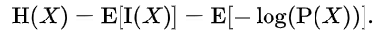
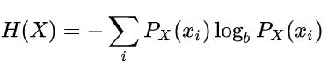
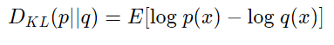
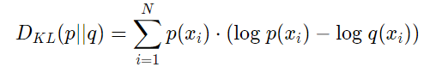
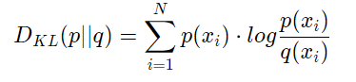
About Kullback-Leibler Divergence
Part 0 - An Introduction To The Problem
Entropy:
Shannon defined the entropy H of a discrete random variable X as:
With K-L divergence we can measure how a PDF is close to another PDF. Essentially, what we’re looking
at with the K-L divergence is the expectation of the log difference between the probability of data in the
original distribution with the approximating distribution:

Slide 4
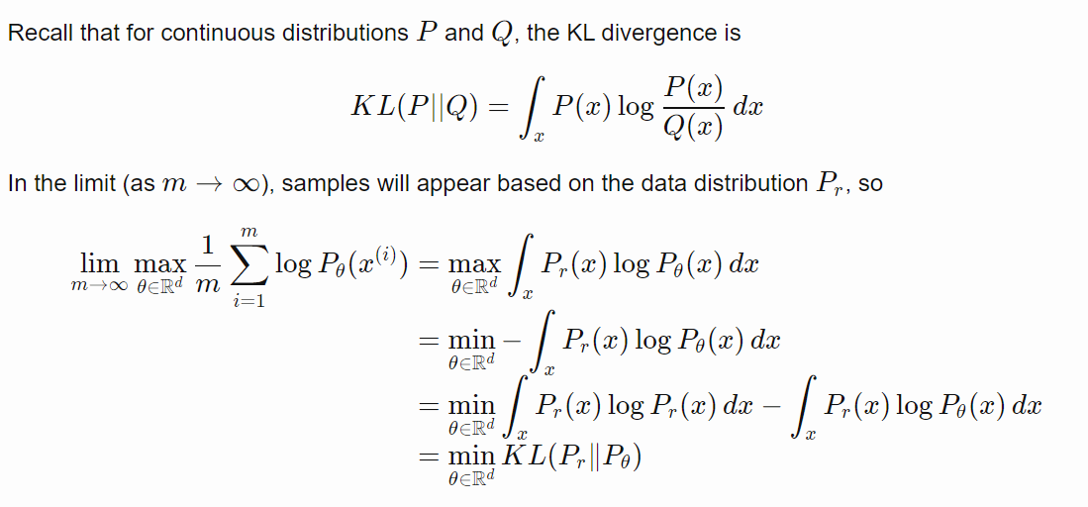
Maximizing log likelihood is equivalent to minimizing KL divergence
Part 0 - An Introduction To The Problem

Slide 5
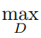
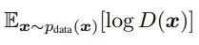
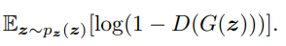
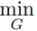
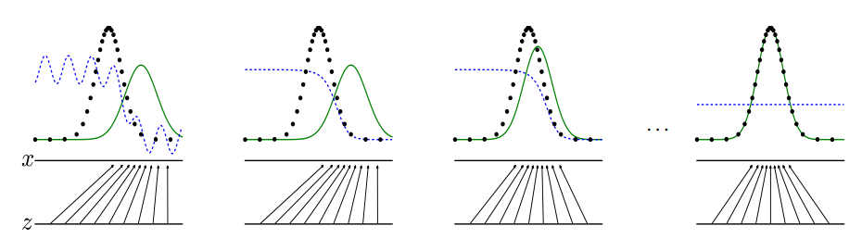
GAN introduction
Part 1 - Vanilla GAN
We simultaneously train two models: a generative model G that captures the data distribution, and a discriminative model D that estimates the probability that a sample came from the training data rather than G. The training procedure for G is to maximize the probability of D making a mistake. This framework corresponds to a minimax two-player game. In the space of arbitrary functions G and D, a unique solution exists, with G recovering the training data distribution and D equal to 1/2 everywhere

Slide 6
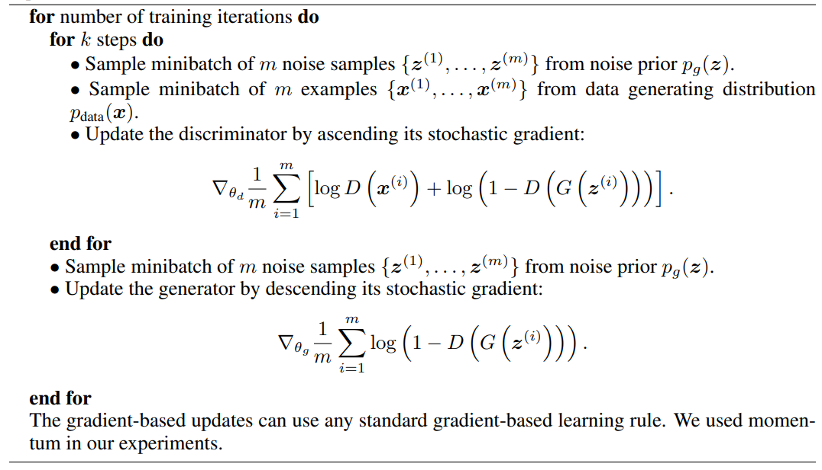
Training of generative adversarial nets
Part 1 - Vanilla GAN

Slide 7
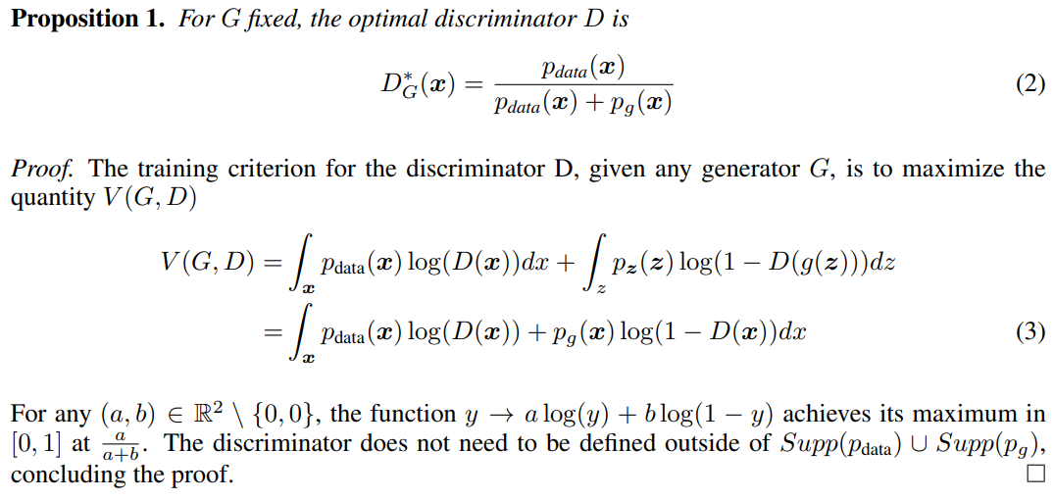
Part 1 - Vanilla GAN

Slide 8
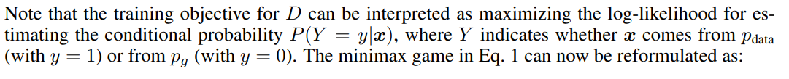
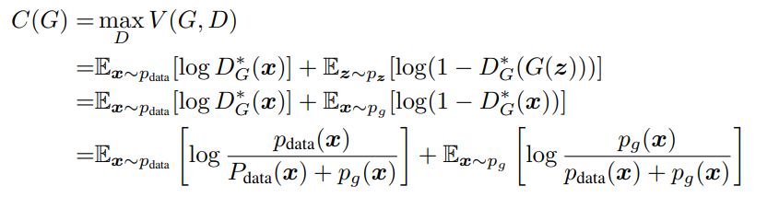
Part 1 - Vanilla GAN

Slide 9
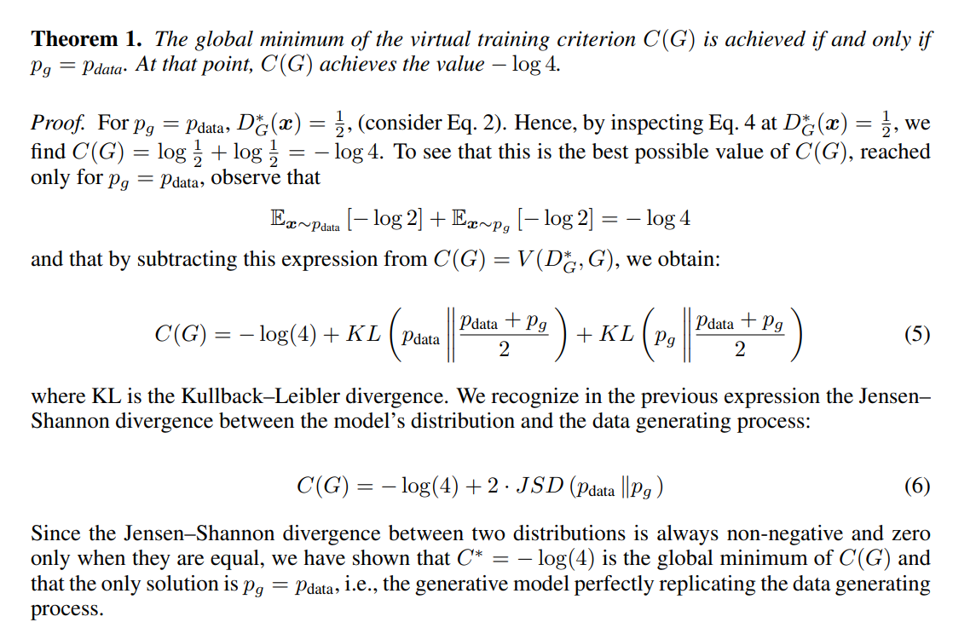
Part 1 - Vanilla GAN

Slide 10
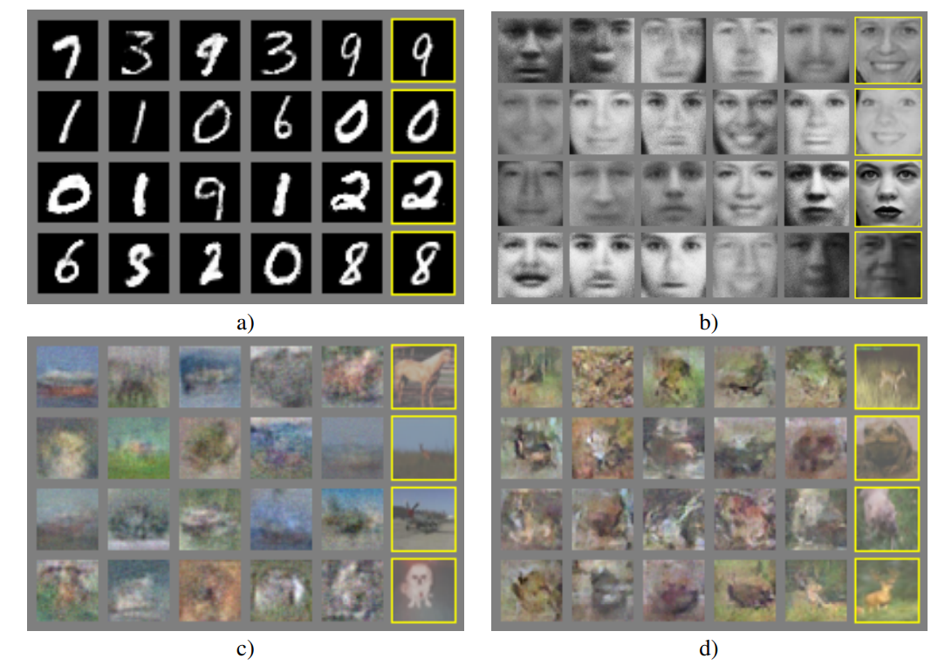
Experiments
Part 1 - Vanilla GAN

Slide 11
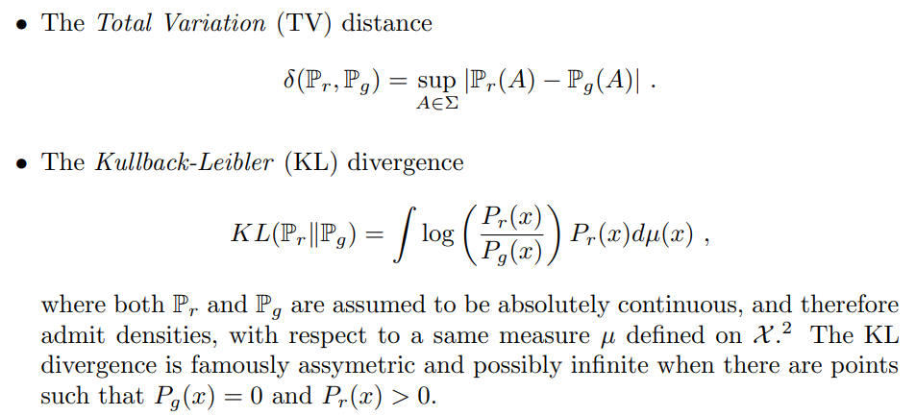
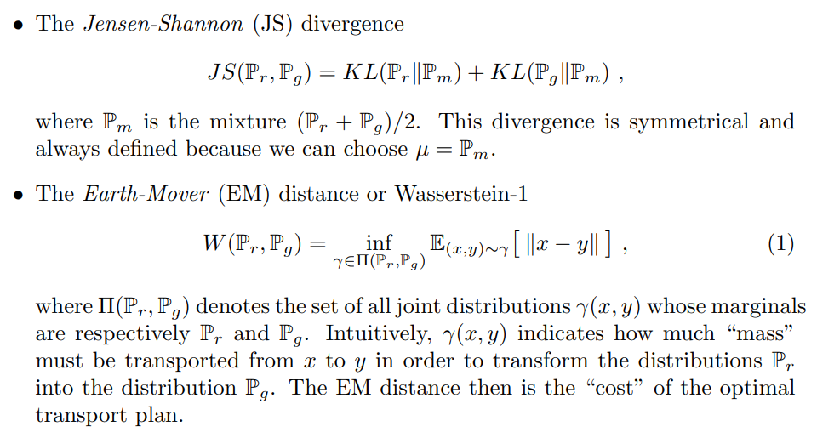
Different Distances
Part 2 - Wasserstein GAN

Slide 12
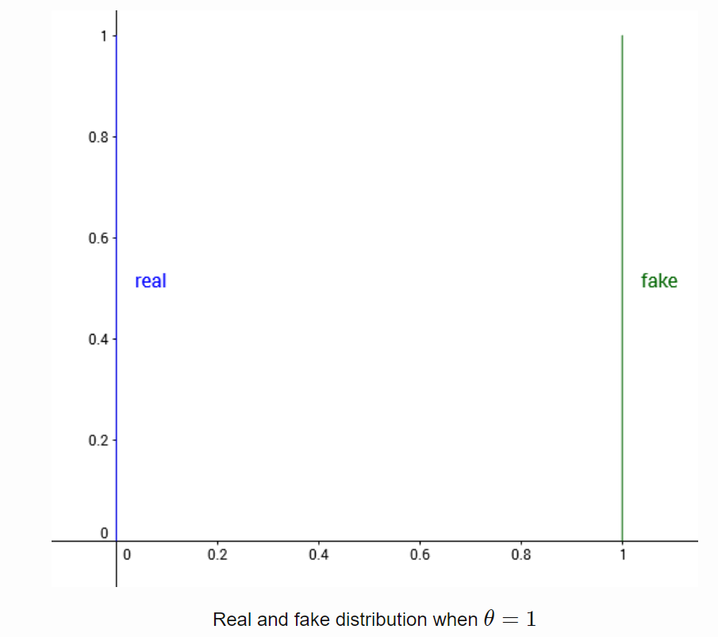
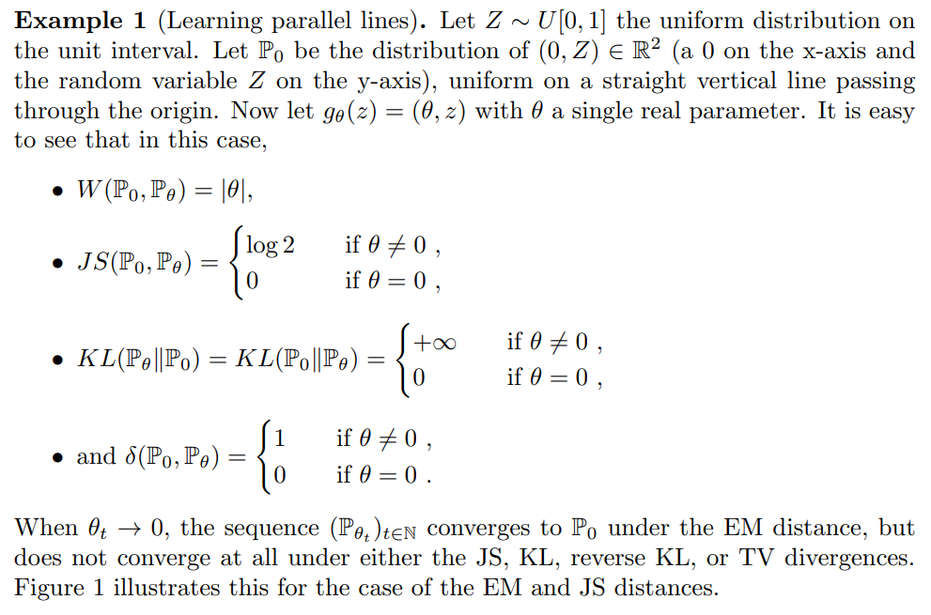
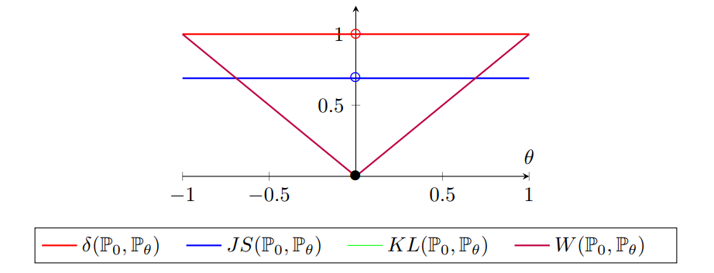
Part 2 - Wasserstein GAN
Learning Parallel lines

Slide 13
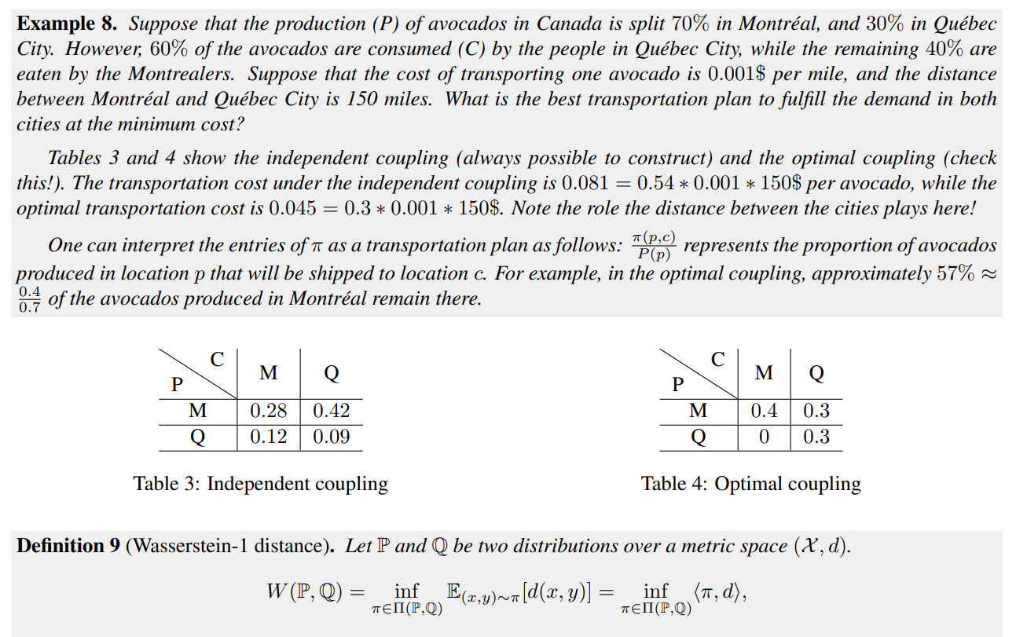
Optimal Transport And Wasserstein Distance
Part 2 - Wasserstein GAN

Slide 14
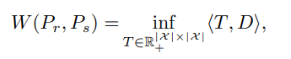
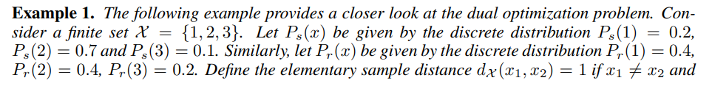
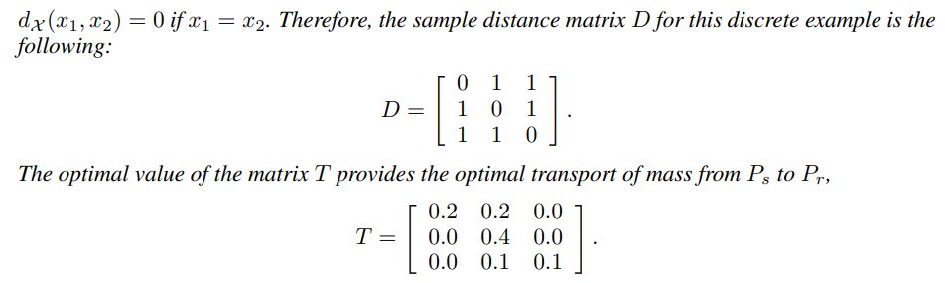
Optimal Transport And Wasserstein Distance
Part 2 - Wasserstein GAN

Slide 15
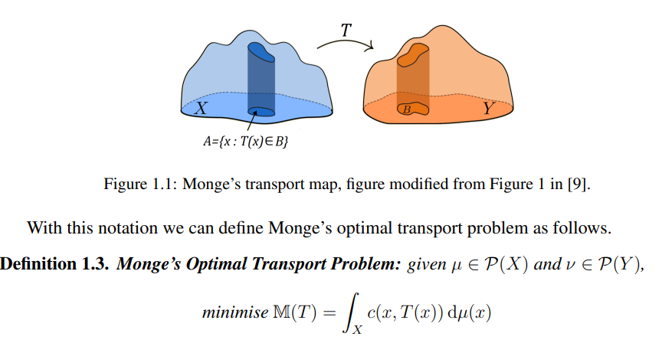
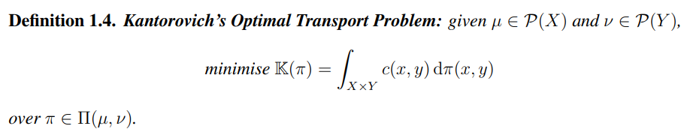
Optimal transport 2 formulations
Part 2 - Wasserstein GAN

Slide 16
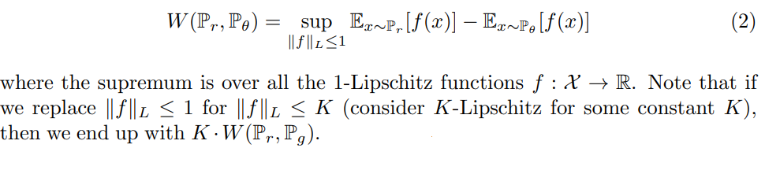
Kantorovich-Rubinstein duality
Part 2 - Wasserstein GAN
Kantorovich-Rubinstein duality says that they’re equivalent problems

Slide 17
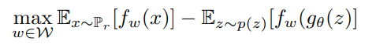
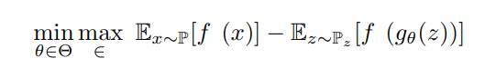
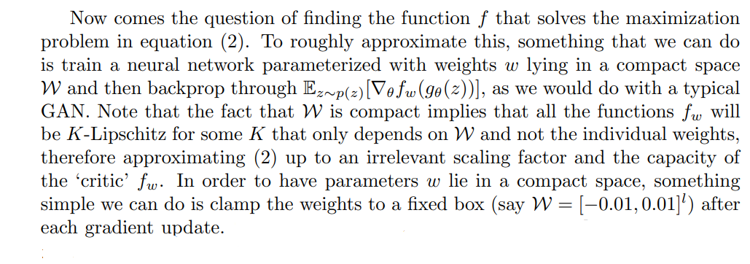
Final loss function for neural network setup
Part 2 - Wasserstein GAN
And again min-max game to train the full system

Slide 18
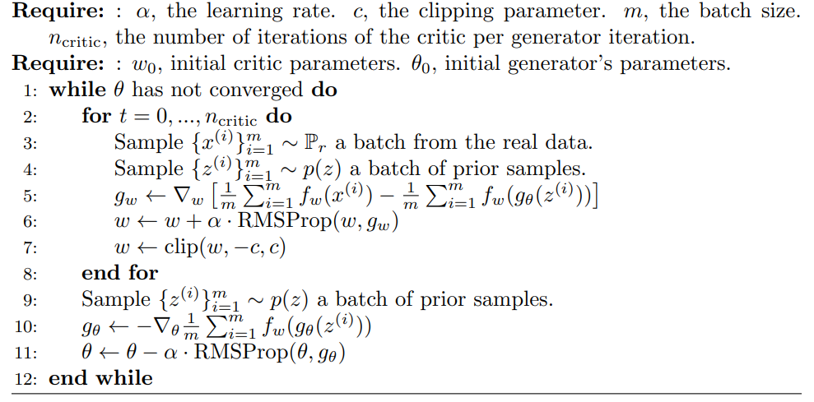
Training of WGAN
Part 2 - Wasserstein GAN

Slide 19
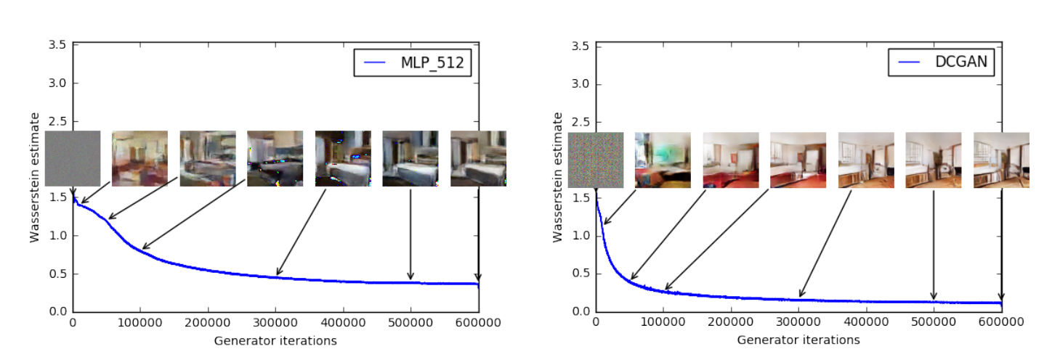
Experiments
Part 2 - Wasserstein GAN

Slide 20
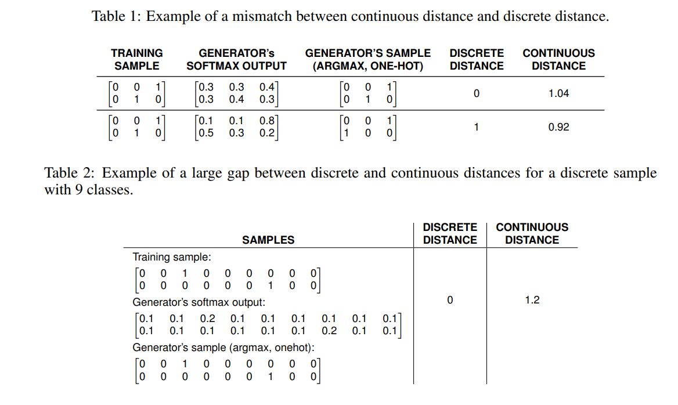
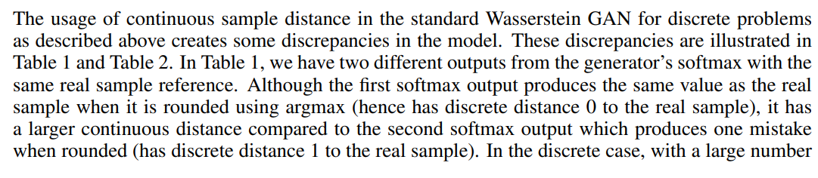
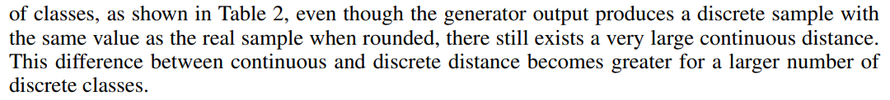
Part 3 - Discrete Wasserstein GAN
Introduction

Slide 21
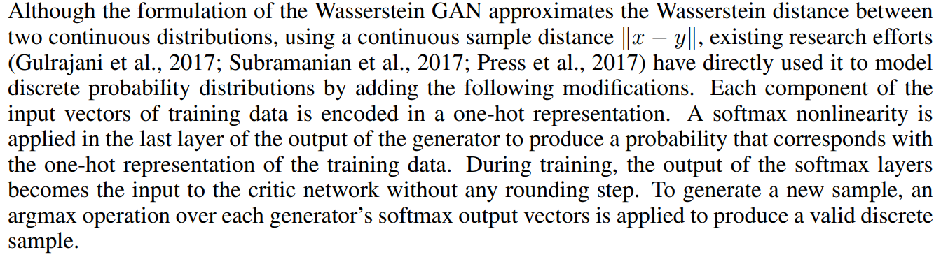
Use of Wasserstein Distance for Discrete Problems
Part 3 - Discrete Wasserstein GAN
A vector of size m is mapped to a matrix of size (mxk) For example: (0 4 5 0) becomes a matrix (4x5):
0 0 0 0 0
0 0 0 1 0
0 0 0 0 1
0 0 0 0 0

Slide 22
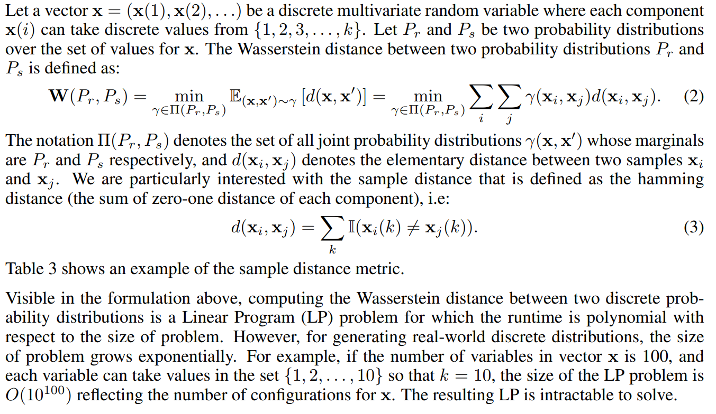
Wasserstein Distance For Discrete Distribution
Part 3 - Discrete Wasserstein GAN

Slide 23
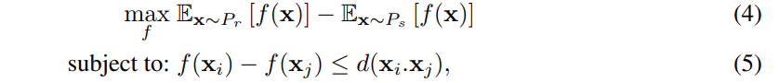
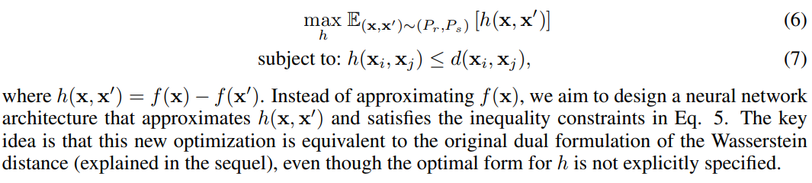
DWGAN Architecture
Part 3 - Discrete Wasserstein GAN
With Kantorovich duality we can instead solve the following optimization problem:
The function f maps a sample to a real value. Note that unlike for the continuous Wasserstein distance, in which the maximization is over all 1-Lipschitz functions without additional constraints, the maximization above is over all functions that satisfy the inequality constraints in Eq. 5.
We note that the maximization in the dual formulation is equivalent to the following optimization:

Slide 24
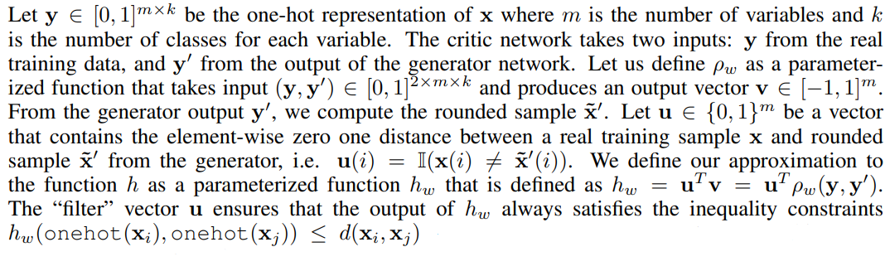
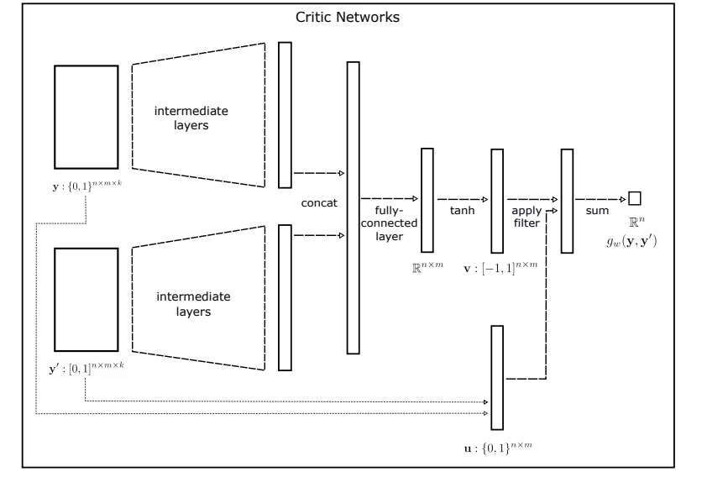
DWGAN Architecture
Part 3 - Discrete Wasserstein GAN

Slide 25
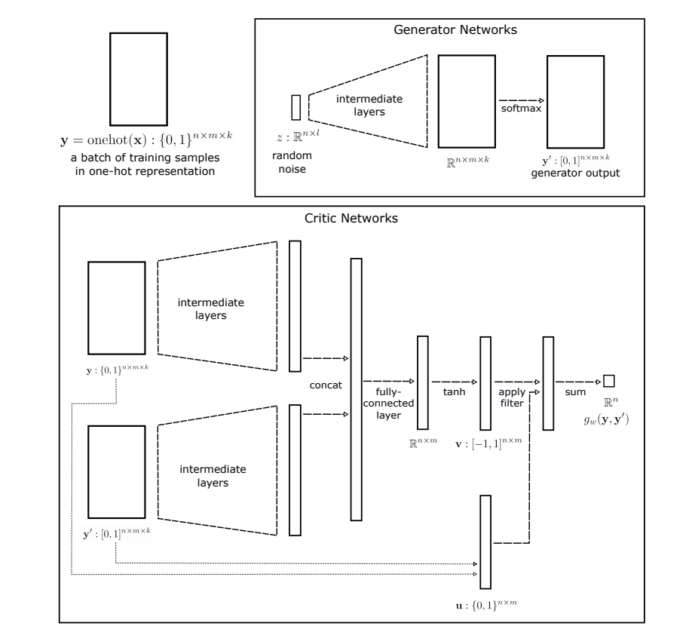
DWGAN Architecture
Part 3 - Discrete Wasserstein GAN

Slide 26
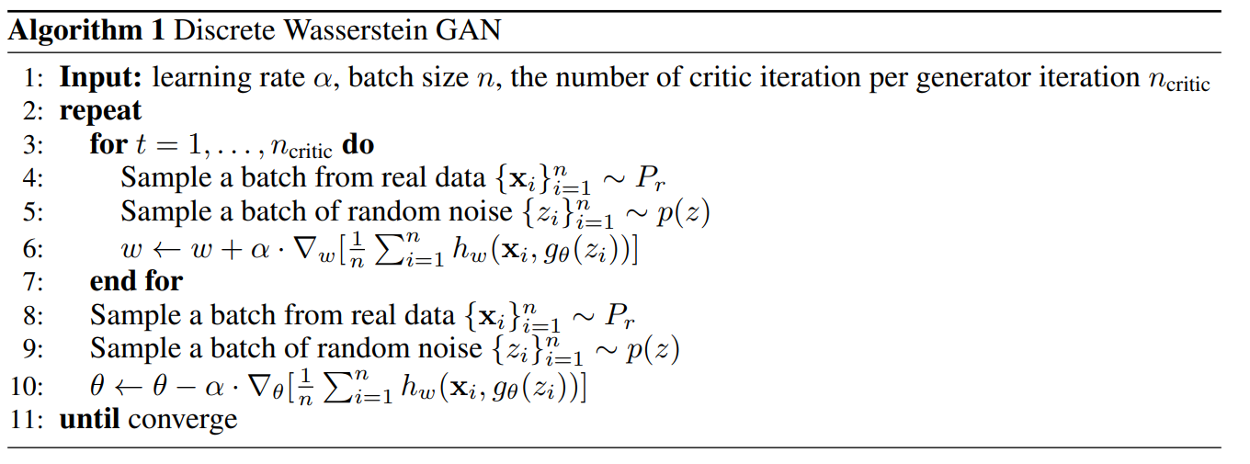
DWGAN Learning Algorithm
Part 3 - Discrete Wasserstein GAN

Slide 27
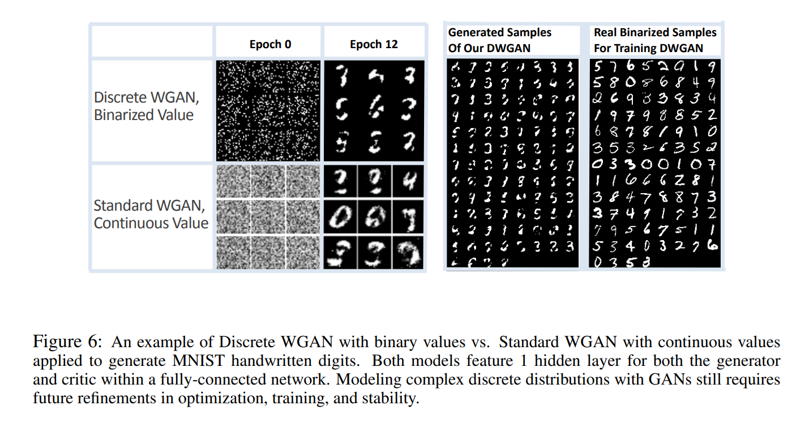
Experiments
Part 3 - Discrete Wasserstein GAN

